Slide 1
What is an RTOS?
Real-Time Operating System (RTOS)
Think: Small and Fast
Dedicated Purpose
Real-time, Deterministic Processing
Typical MCU (<512KB memory, <200MHz, 32-bit, MMU not req.)
Notes:
Top Points:
RTOS stands for Real-Time Operating System
The highest level idea is that an RTOS is small and fast, 2KB minimal footprint, 50KB for Azure IoT connectivity, and sub-microsecond context switching
An RTOS is also used in devices that have a dedicated purpose, like a FitBit. The application code is typically linked and located with the RTOS itself.
Most good RTOS solutions can meet difficult real-time requirements and are necessarily deterministic (predicable)

Slide 2
RTOS vs. GPOS
Notes:
Top points:
For a point of reference, let’s look at General Purpose Operating Systems (GPOS) vs. RTOS. Most of us have used and know something about GPOS. Both GPOS and RTOS perform multithreading, however, they are very different in functionality and size
The size of an RTOS is orders of magnitude smaller than Linux or Windows
For example, Azure ThreadX requires as little as 2KB of instruction area memory.

Slide 3
RTOS vs. GPOS Summary
Recommended memory requirements for typical Linux distributions is 2GB+ (some custom distributions require as little as 1MB). RTOS 2KB
Linux/Windows typically need processors running at 1GHz+(some as low at 500MHz). RTOS can run on 32MHz processors
Linux/Windows require MMU -- RTOS does not require an MMU
Linux/Windows typically run on 32-bit and 64-bit processors. RTOS runs on 16-bit, 32-bit, and 64-bit processors--32-bit being the most common
Notes:
Top Points:
Size is a big difference between RTOS and GPOS.
Speed is another big difference between RTOS and GPOS. The size and speed differences also translate to significant power consumption differences.
An RTOS does not require an MMU for virtual memory support, while a GPOS does require an MMU
RTOS can run on 16-bit processor, while most GPOS run on 64-bit processors

Slide 4
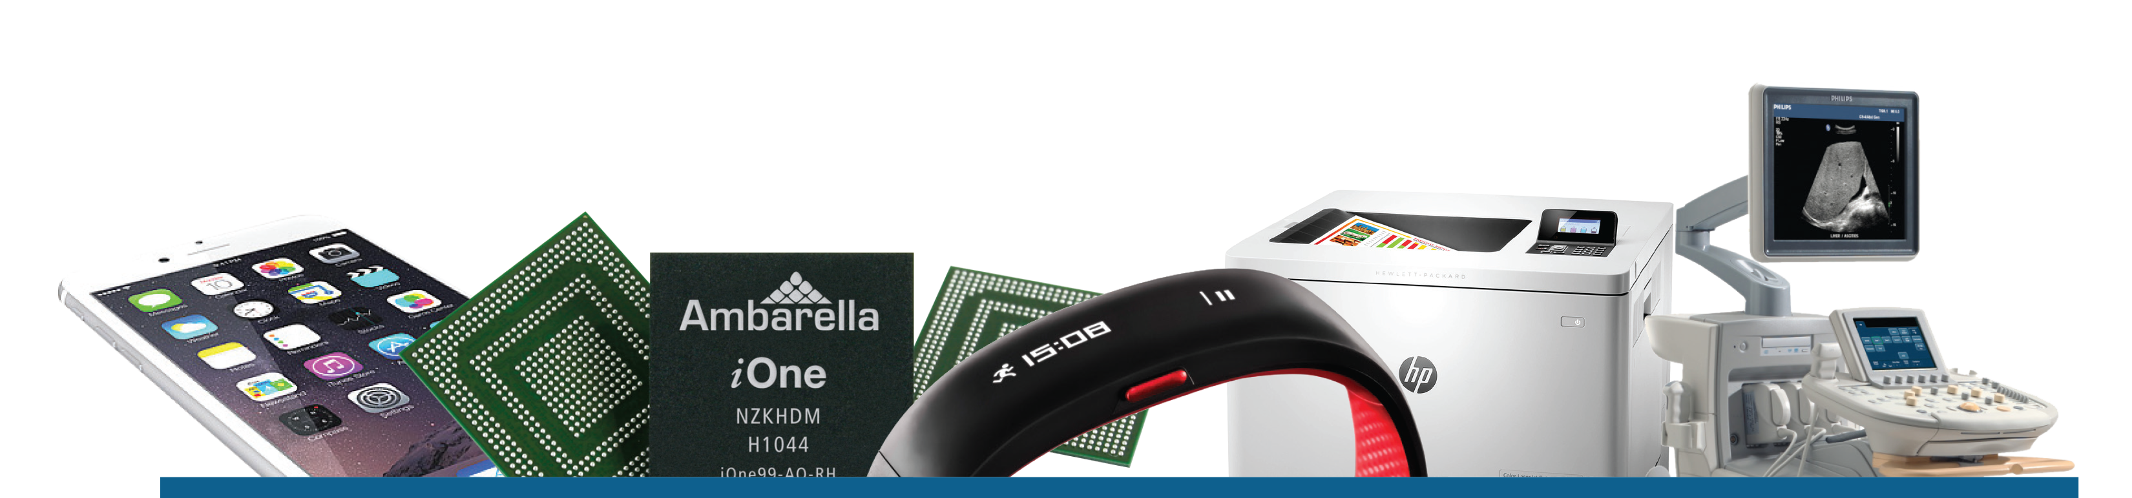

Azure RTOS ThreadX
6.2 BILLION THINGS
“We have followed the growth trajectory of ThreadX in the wireless and IoT markets since the company’s founding, and are increasingly impressed by the widespread industry adoption of ThreadX,” said Chris Rommel, Executive Vice President, VDC Research.
Notes:
Top Points:
Per VDC Research in 2017 there were an estimated 6.2 Billion deployments of Azure RTOS ThreadX wordwide
Given the rate of growth in deployments, there are over 7 Billion deployments of Azure RTOS ThreadX today
While there are open source RTOSes that are widely used, Azure RTOS ThreadX is one of the most deployed RTOSes for serious commercial products

Slide 5
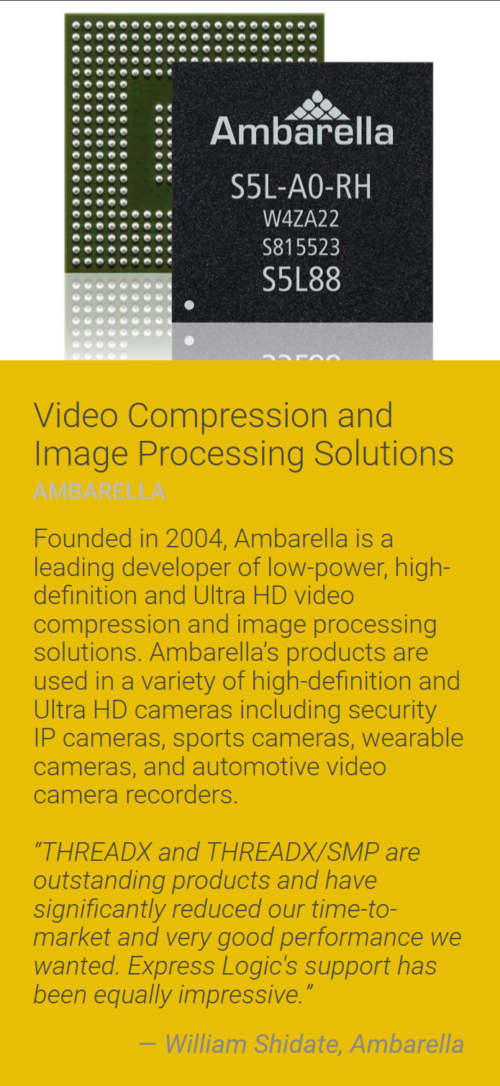
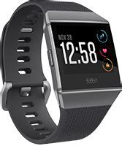
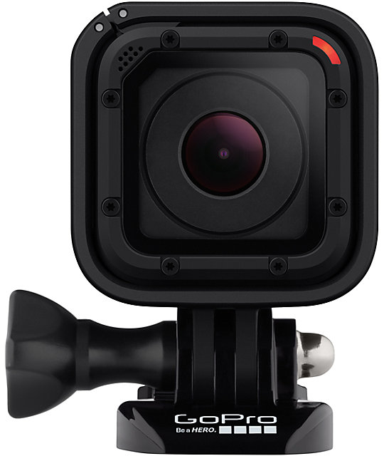
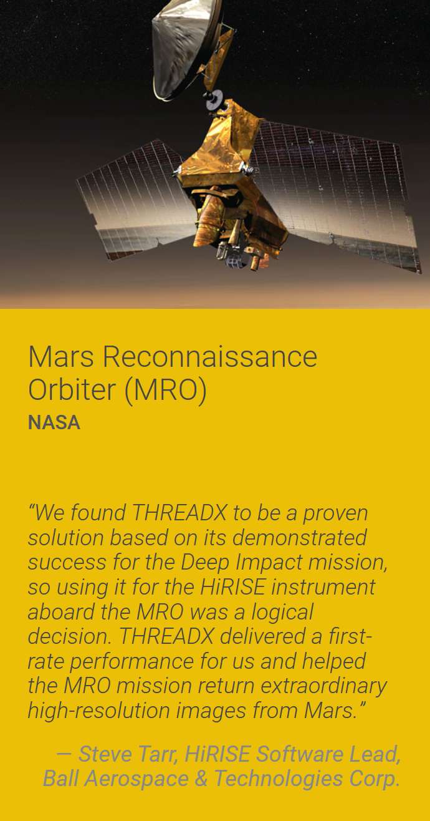
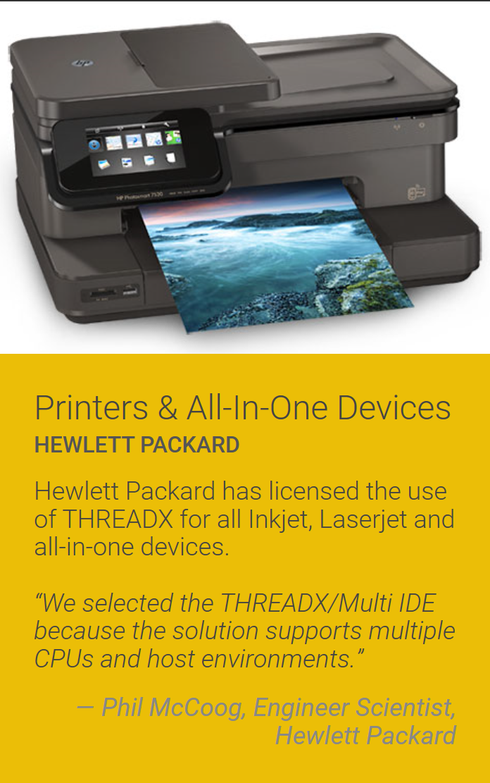
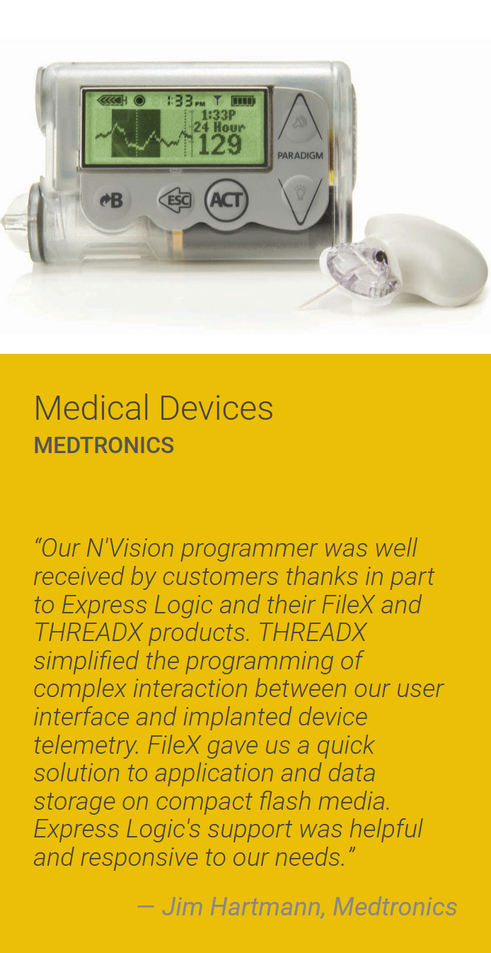

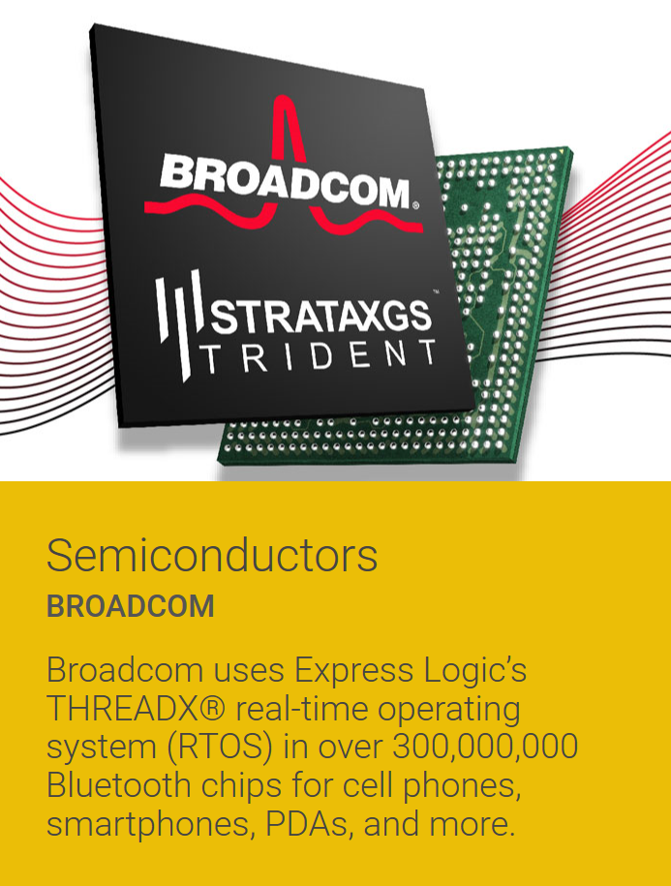
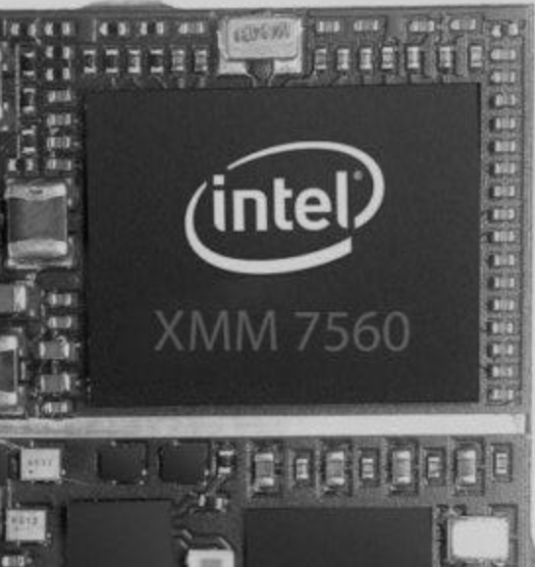

Notes:
Top Points:
These are some examples of devices that use Azure RTOS ThreadX – everything from small wearables like Fitbit to space probes. HP printers to GoPro cameras. Please see product showcase on RTOS.COM for more examples.
Many SoCs are based on Azure RTOS ThreadX, including the Apple iPhone modem (formerly Intel Mobile). In fact, Azure RTOS ThreadX is present multiple times in many smart phones, e.g., modem, Bluetooth, GPS chipsets.
There is a good chance we have all used a product with Azure RTOS ThreadX today.

Slide 6

Some RTOS History
1990
1991
1993
1997
1999
Nucleus
uC/OS
Nucleus PLUS
THREADX
FILEX
2014
2008
2007
2004
2003
2002
GUIX/GUIX Studio
TRACEX
NETX DUO
USBX
FreeRTOS
NETX
2017
2017
2019
2020
Amazon acquires
FreeRTOS
6.2B ThreadX
Deployments
Microsoft
Acquired
Express Logic
Microsoft
Azure RTOS
Notes:
Top Points:
Nucleus developed/introduced in 1990 (major RTOSes at the time were VRTX, pSOS, and VxWorks)
uC/OS introduced in 1991
ThreadX introduced in 1997, VRTX, pSOS, VxWorks, Nucleus popular
Additional products introduces after ThreadX

Slide 7
Azure RTOS:
Making IoT Development Easier!
SMALL
SAFE
SECURE
ADVANCED
FAST
EASY
ThreadX minimal 2KB FLASH, 1KB RAM
Cloud Connectivity < 50KB
Safety certified to IEC 61508, 62304, ISO 26262, EN 50128, UL/IEC 60730/335, UL 1998
IPsec, TLS/DTLS, Memory Protection, TrustZone, and
EAL4+ Common Criteria,
PSA Level 1, FIPS 140-2
Preemption-threshold, event chaining, exFAT, multicore – AMP/SMP, and more
Sub-microsecond context switch, wire speed networking, deterministic
Easy to Use - Intuitive API, great documentation, support for most popular processors and tools, customer support
Notes:
Top Points:
Our top three benefits are: SMALL, SAFE and SECURE
Small footprint: 2KB minimal Azure RTOS ThreadX footprint. Device-to-cloud 50KB (Azure RTOS ThreadX+NetX Duo+NetX Secure TLS+NetX MQTT)
Core components (Azure RTOS ThreadX, FileX, GUIX, NetX Duo, and USBX) pre-certified to SIL 4, ASIL D, Medical Class C, and UL. (Note that no other RTOS offering has such pre-certification – especially for the middleware)
Security protocols like TLS, DTLS, and Ipsec are supported. Crytpo library has been pre-certified to FIPS 140-2. Cloud connectivity via MQTT/TLS has been EAL4+ security certified.

Slide 8
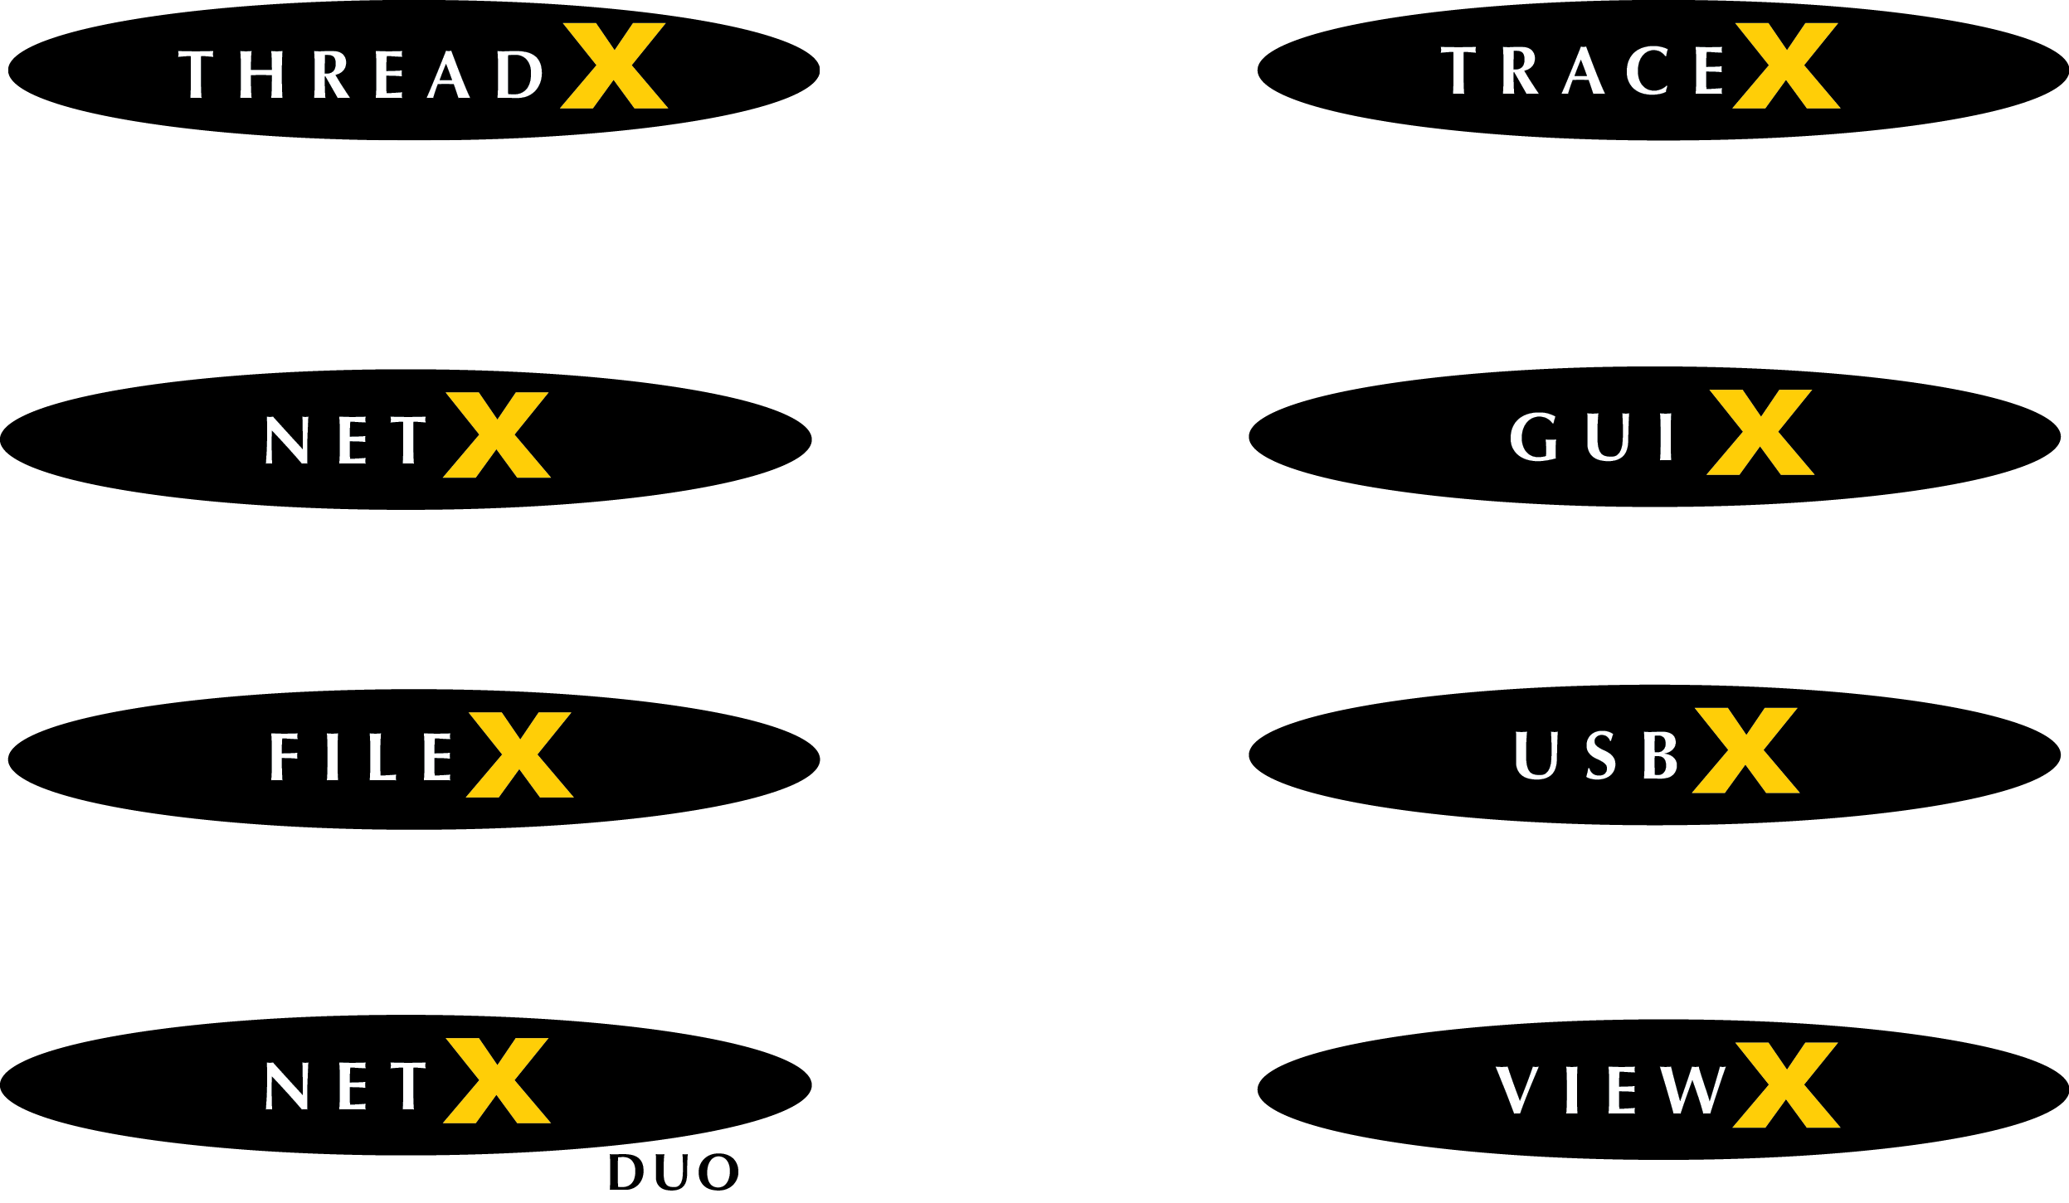


Azure RTOS
Most Comprehensive Solution
Notes:
Top Points:
Most comprehensive RTOS solution. Most open source solutions come do not cover middleware like FileX, GUIX, NetX Duo and USBX
All products are written from scratch to the same rigorous coding and documentation standards. They share the same look-and-feel and are therefore easier to use than competing solutions – especially in comparison to open source.
All products are run-time except two Windows-based tools: GUIX Studio and TraceX

Slide 9
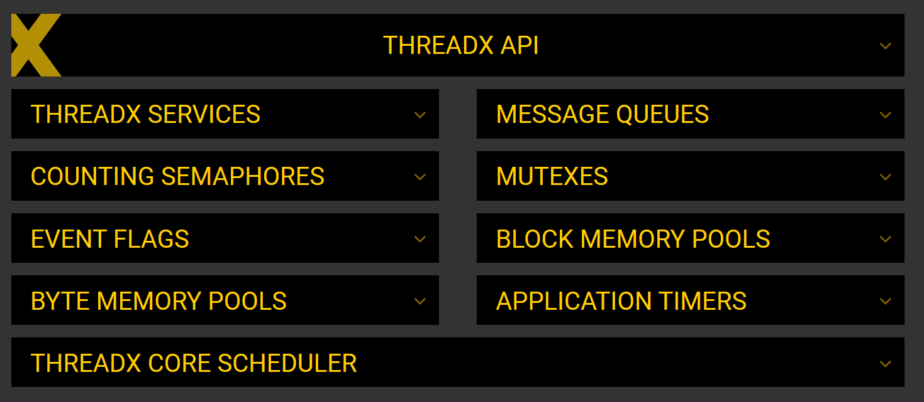

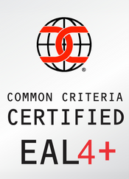
2K
Min Footprint
SIL 4, ASIL D,
Med Class C
RTOS.COM
Notes:
Top Points:
Azure RTOS ThreadX is a real-time, priority based preemptive RTOS.
2KB minimal footprint; because of loosely coupled C library implementation ThreadX automatically scales based on what the customer needs.
Safety pre-certified to SIL 4, ASIL D, Medical Class C, and UL.
Part of EAL4+ security certification for cloud connectivity.
Please see ThreadX page on RTOS.COM for additional details, including an interactive block diagram shown

Slide 10
Noteworthy ThreadX Features
Easy-to-Use – Include tx_api.h and link with tx.a
Application controls resources at run-time, dynamic create/delete
Small - implemented as a loosely coupled C library (auto scale)
Unique features: preemption-threshold, event-chaining, fast timers…
Fast, deterministic processing (# of ready threads does not impact)
ThreadX Modules with MPU/MMU memory protection
Support for 16-bit, 32-bit, 64-bit & Multi-Core
Notes:
Top Points:
Easy to use ThreadX, it’s basically include tx_api.h, call tx_kernel_enter, define tx_application_define, and link with tx.a
Application has run-time control of resources (memory supplied by application) and can dynamically create/delete resources like threads, queues, etc.
ThreadX is small and automatically scales based on what the customer uses
ThreadX offers advanced features like preemption-threshold, event-chaining, fast software timers, per-compilation unit error checking enable/disable
ThreadX is fast and deterministic – thread scheduling is not affected by the total number of threads or the number of ready threads
ThreadX Modules offers process like isolation with MPU/MMU memory protection when available
Support for small 16-bit parts all the way through multi-core, SMP 64-bit parts. 32-bit parts are the most common

Slide 11
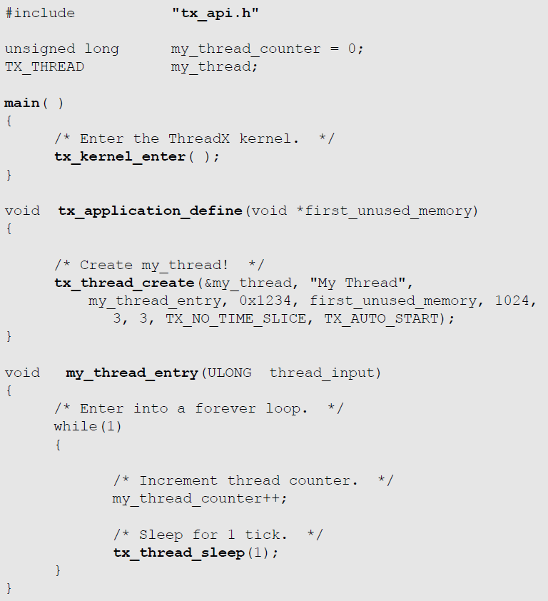
Using ThreadX is Simple:
Notes:
Top Points:
Easy to use ThreadX, it’s basically include tx_api.h, call tx_kernel_enter, define tx_application_define, and link with tx.a

Slide 12
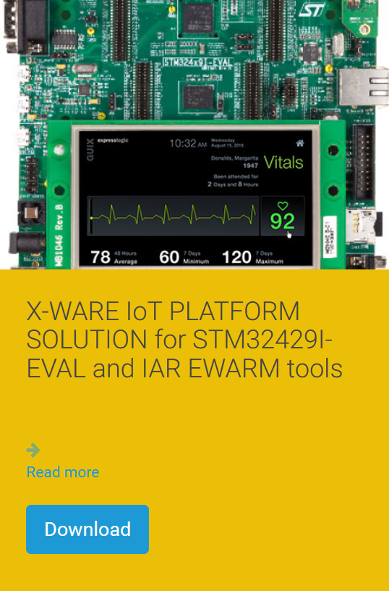
Typical ThreadX Platform:
See RTOS.COM for
More evaluation downloads
Notes:
Top Points:
Easy to use ThreadX, it’s basically include tx_api.h, call tx_kernel_enter, define tx_application_define, and link with tx.a

Slide 13
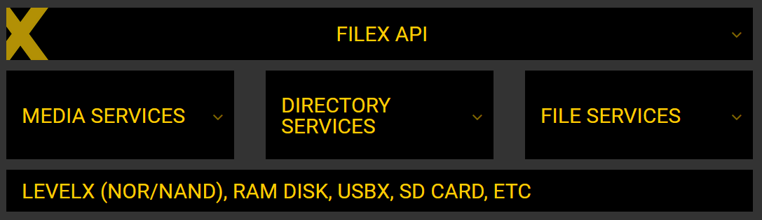
9K
Min Footprint
RTOS.COM
SIL 4, ASIL D,
Med Class C
Notes:
Top Points:
FileX is our embedded file system that supports 12/16/32 FAT and exFAT formats.
9KB minimal footprint; because of loosely coupled C library implementation FileX automatically scales based on what the customer needs.
Fault tolerant support via journaling.
Safety pre-certified to SIL 4, ASIL D, Medical Class C, and UL (only FAT file system to have this certification).
Please see FileX page on RTOS.COM for additional details, including an interactive block diagram shown

Slide 14
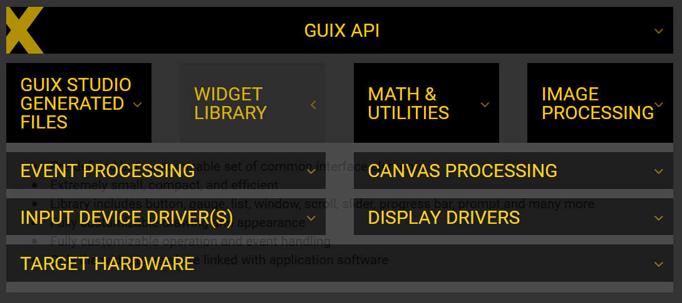
14K
Min Footprint
RTOS.COM
SIL 4, ASIL D,
Med Class C
Notes:
Top Points:
GUIX is our 2D graphics run-time engine, ideal for small screens on embedded devices.
14KB minimal footprint; because of loosely coupled C library implementation GUIX automatically scales based on what the customer needs.
Support for a variety of 2D screen technology, sizes and properties
Safety pre-certified to SIL 4, ASIL D, Medical Class C (only GUI run-time to have this certification).
Please see GUIX page on RTOS.COM for additional details, including an interactive block diagram shown

Slide 15
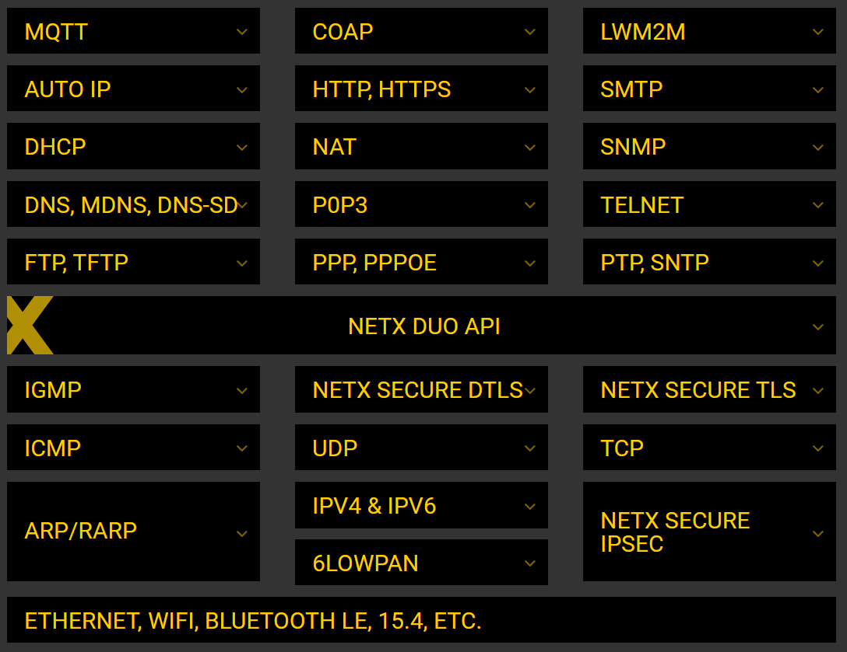
50K
Device-2-Cloud
RTOS.COM
SIL 4, ASIL D,
Med Class C
Notes:
Top Points:
NetX Duo is our IPv4/IPv6 network stack, including security and cloud protocols with near wire speed performance.
50KB minimal footprint for cloud connection; because of loosely coupled C library implementation NetX Duo automatically scales based on what the customer needs.
Extensive set of network protocols – much greater than typical open source solutions
Safety pre-certified to SIL 4, ASIL D, Medical Class C (only network stack to have this certification)
Please see NetX Duo page on RTOS.COM for additional details, including an interactive block diagram shown

Slide 16
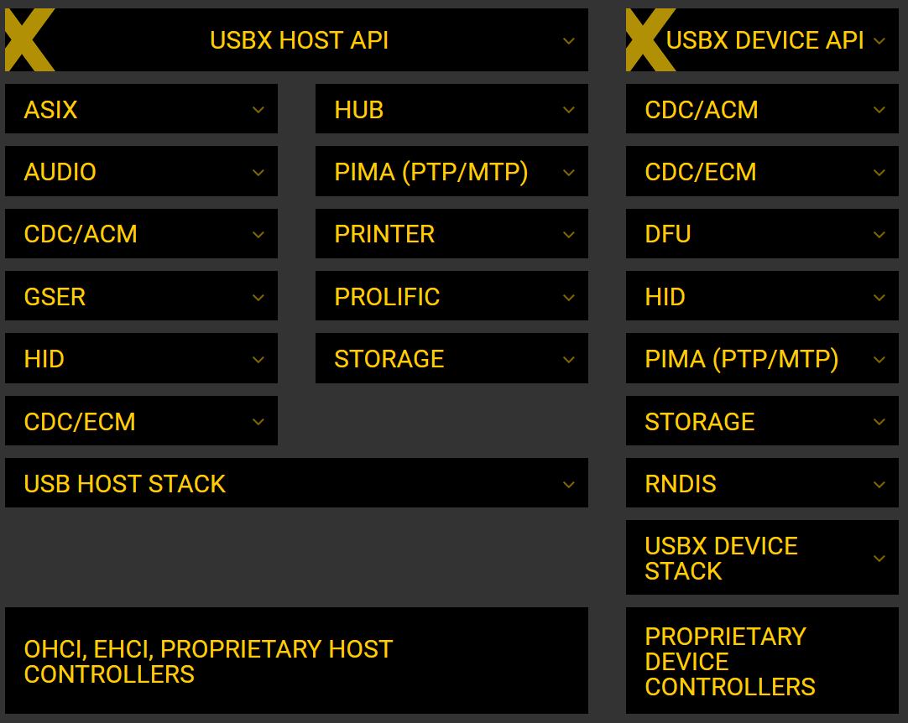
11K
Min Footprint
RTOS.COM
SIL 4, ASIL D,
Med Class C
Notes:
Top Points:
USBX is our USB host/device stack that supports most of the popular USB classes.
11KB minimal footprint for cloud connection; because of loosely coupled C library implementation USBX automatically scales based on what the customer needs.
Extensive set of host/device classes and controller support.
Safety pre-certified to SIL 4, ASIL D, Medical Class C (only USB stack to have this certification)
Please see USBX page on RTOS.COM for additional details, including an interactive block diagram shown

Slide 17
Embedded Best Practices
Keep things simple – don’t over engineer. Solve 95% case in the most efficient manner as possible
Write docs/user guides first – before C code
Always think small & fast – every byte and every cycle counts
Think security from the start: Special consideration to buffer/stack overflow and location of buffers. Buffer overflow can be serious!
Use HW watchdog, MPU/MMU, prevent RAM execution
Never enough testing – strive for 100% statement and branch decision coverage
Notes:
Top Points:
Keep things simple
Writing doc first puts focus on the user experience and allows docs to go into production in parallel with code
Don’t add unnecessary features that can’t be easily removed or on by default. Embedded systems can be extremely size/speed sensitive
Think of security from the beginning – buffer overflow can result in remote execution
Use HW features
Always bugs in software, but the more testing the more reliable the software will be

Slide 18
An Embedded Career
Over 10 Billion MCUs produced every year
IoT should cause even greater numbers of MCUs
Not enough embedded engineers – high demand!
Cool products to work on – see showcase on RTOS.COM
What do you need:
Strong CS, data structure, and algorithm background
Know C programming language (95% of embedded dev is in C)
Desire to be close to the metal
Notes:
Top Points:
Over 10B MCUs produced every year… and IoT promises to increase that number!
We can’t find enough embedded engineers, so good embedded engineers usually have more opportunities
Cool products to work on – from fitbits to space probes and everything in between!

